Slide 1
Microservices and DevOps
Scalable Microservices
Replication and Redundancy
Henrik Bærbak Christensen

Slide 2

Literature
Colouris, Dollimore, Kindberg, 2001
Gets deep into the details of reliable communication, byzantine failures, etc.
We approach it from the architectural level
Terminology
Overall protocol

Slide 3
Replication
Replication: Maintenance of copies of data at multiple computers
As always – not only one architectural quality is affected but several
Availability increase:
Our primary concern in MSDO
If one man is down, another man can take over
Performance increase:
More men can pull more load
Bass Tactic: Maintain multiple copies of data

Slide 4
Replication
But
Cost:
Two nodes cost more than one
Reliability:
More complex algorithms increase probability of error (fail-over, ping-echo, voting, …)
Data consistency
What if A reads from node X while B writes to node Y ?
CAP theorem
Consistency: All see same data
Availability: Every request is served
Partition Tolerance: Operational despite arbitrary failures
RDB goes for C while NoSQL (generally) goes for A

Slide 5
Discussion
Redundancy: In engineering, redundancy is the duplication of critical components or functions of a system with the intention of increasing reliability of the system, usually in the form of a backup or fail-safe. [Wikipedia]
What is the difference from replication?
Which Nygard pattern covers ‘redundancy’?
Notes:
Bulkheads and horizontal scaling are examples of redundancy

Slide 6
Availability Calculations
If a system of n replicated servers in which each server has a probability, p, of failing, then the system has total probability
p^{n} of failing
Ex
p = 5% (0.05)
(72 minutes every 24h)
n = 3
Overall failure rate:
0.05³ = 0.000125 = 0,125 per mille
(10 seconds every 24h)
That is:
1 - p^{n} availability

Slide 7
Active Replication
Fully redundant primaries

Slide 8
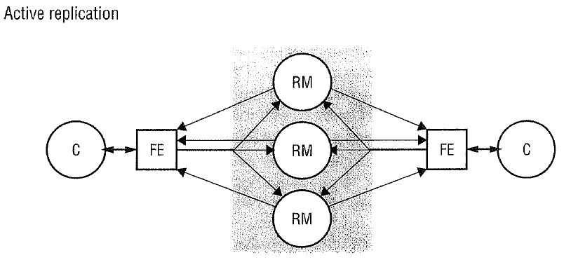
Architecture
Clients multicast requests to all nodes
All nodes process identically but independently and reply
Front-End receives answers
May do one of several things: Use first one, compare, vote…

Slide 9
Active Replication
Benefits
No performance penalty for failures
(no promotion of a slave to become primary, all are primary)
(Potentially) Simpler servers
Less need for hand-shaking
Still need state resynchronization code in case a node has failed and need to get up-to-date
Liabilities
No better performance than if using only one node
Complexity in front-end
Multicast, voting, ...
Consistency amongst nodes...

Slide 10
Passive Replication
Master/slave
Primary/backup

Slide 11
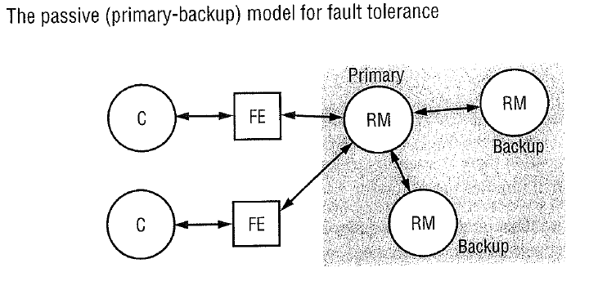
Architecture
One node is primary
executes operations (notably writes/updates)
sends copies to slaves (in case of write/update)
Primary failure
One slave is promoted to become primary
What is the FrontEnd = FE?

Slide 12
Passive Replication
Liabilities
Additional complexity in algorithms to keep slaves up-to-date, ensuring consistency, etc...
It takes time for the slaves to note that the primary is gone and promote one as new primary
MongoDB – up to one minute
Meanwhile the clients are waiting – slow response
Primary takes all requests
No obvious performance gain from balancing load
Storage requirements
N nodes require N times storage
EcoSense: for every 1TB extra diskspace we pay for 3 TB

Slide 13
Example: MongoDB
MongoDB: Replica Sets
Built to run on commodity hardware
That is, the stuff that you buy in a shop, not necessarily the stuff the IT department has in the server room
Commodity disks, however, have higher failure rates
But – avoid failures by using replication
Three is a recommendation
Two + arbiter is another option
Arbiter does not store anything but participate in electing a new primary

Slide 14
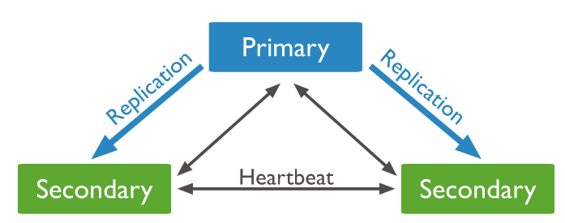
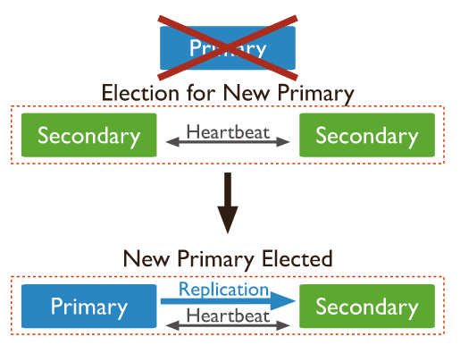
Example: MongoDB
Use heart beat to monitor the replica set

Slide 15
Example: MongoDB
Highly configurable
Write concern
Unacknowledged happy go lucky
Acknowledged primary has received write request
Journaled primary has journaled the write request
Replica Acknowledged n replicas have received write request
Read concerns
Writes go to primary, but all reads may go to slaves
Boosts performance
Sacrifice consistency, you may get old data!
MongoDB is eventual consistent

Slide 16
Redis Cluster
Replication and Sharding and Availability “Det er jo hele tre ting?!?”

Slide 17
Replication
The replication model of Redis is very simple
One instance acts as the ‘master’
Just like we have used it so far..
Assume it is on node ‘redis1:6379’
Then we can start another instance and make it slave
Start another instance, open the ‘redis-cli’ and issue
‘replicaof redis1 6379’

Slide 18
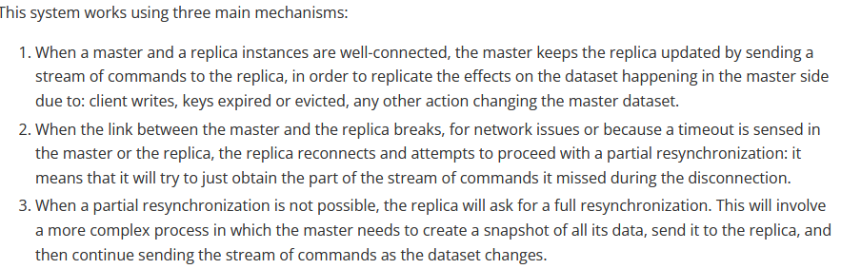
Replication
You can read from the replica but you cannot write to it
And you have to connect to ‘the one you need to speak to’
Redis1 ? Redis2?

Slide 19
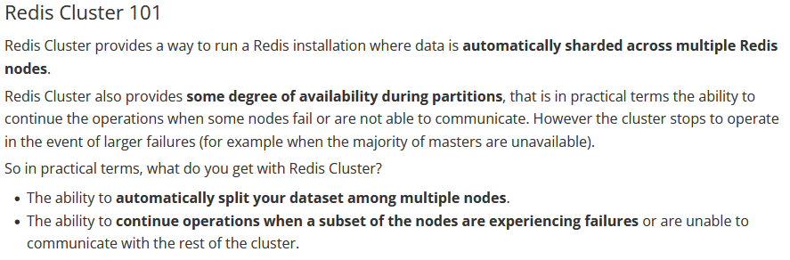
Redis Cluster
Redis Cluster provides
Sharding and Replication and FailOver
https://redis.io/topics/cluster-tutorial

Slide 20

Sharding
Every key is part of a hash slot
Redis has exactly 16384 hash slots
Every key is mapped to one of these hash slots
Every node (master) is responsible for a subset, e.g.
If we add two more nodes (masters), we just move the relevant hash slots to the new masters…
Uhum, transactions need to cover only keys in the same slot ☹
So there is a mechanism to guaranty that… anyway…

Slide 21
Master-Slave
So if we loose master B, then all keys in hash slot 5501 – 11000 are lost ☹
Solved by having a replica of B, let us call it B1

Slide 22
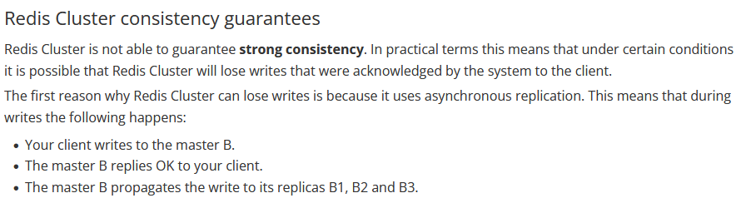
Eventual Consistency (?)
Only a weak consistency…
If B fails before propagating the write, the data is lost!

Slide 23
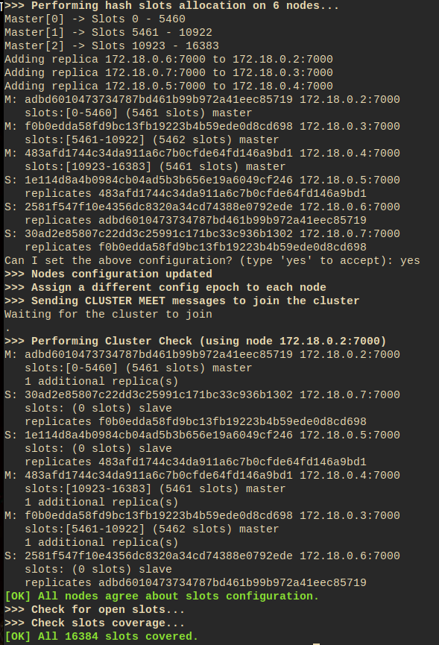
Redis cluster
The minimal cluster requires at least three masters…
So, you need 6 instances!
Three masters (minimum)
And each one with a replica
Ideally, the machines are geographically distributed, of course

Slide 24
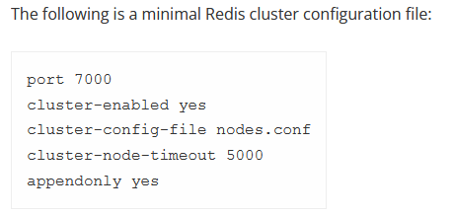
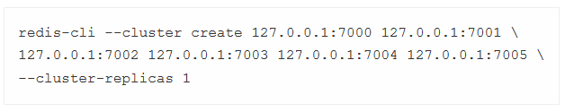
Process
Start 6 instances, configured to cluster mode
Start the ‘redis-cli’ in any node and issue the cluster command
No DNS – Use IP addresses !!!

Slide 25
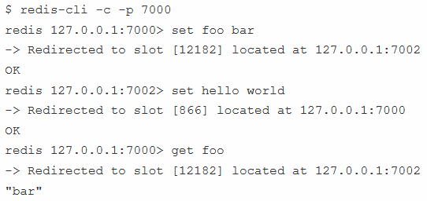
And…
That is it!
Open a cli in any node in cluster mode (-c)

Slide 26
Dockerizing a Manual Test
The fine tutorial requires redis installed on you machine.
It is (almost) as easy to run using Docker but…
You need to create a docker network
So the instances can talk to each other…
Then create the instances
6x the one below, varying the parameters

Slide 27

Dockerizing
Initialize the Cluster
You need the IP addresses on the internal network
docker exec –ti redis1 sh
And issue ‘ifconfig’ to find that
Fortunately Docker assigns them consecutive numbers
And then
Testing

Slide 28
Java Side

Slide 29
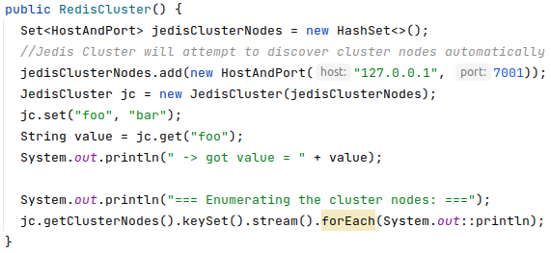
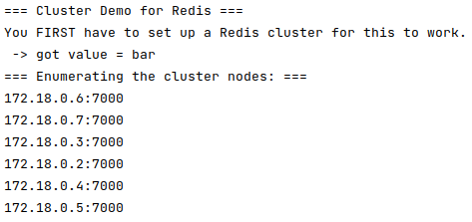

Was…
… actually really easy, as Jedis supports it directly…
Reason for portmapping to localhost

